Slide 1


AIBridge
Lecture 4
Notes:
We’ve spent the past few lectures discussing “supervised” learning. As a recap, “supervised” learning is when you tell your models what outputs they should map to. You have clearly defined “labels”, you give data to your model and it tries to find the “right answer”. But sometimes, you end up with problems that don’t fit neatly into these square boxes or you may not know the shape your data will take until you process it.
(We are no longer creating a function with an output.)
Today, we will be talking about unsupervised learning. Unsupervised learning on the other hand deals with unlabeled data. Effectively, the system tries to find patterns in the dataset, and your data gets grouped up based on these patterns.

Slide 2
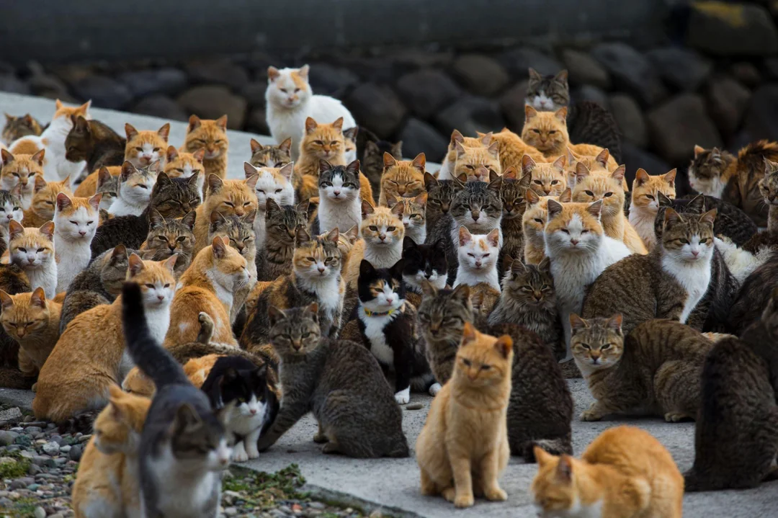
Notes:
And to give you guys a solid understanding, first, I’ll talk about cats

Slide 3
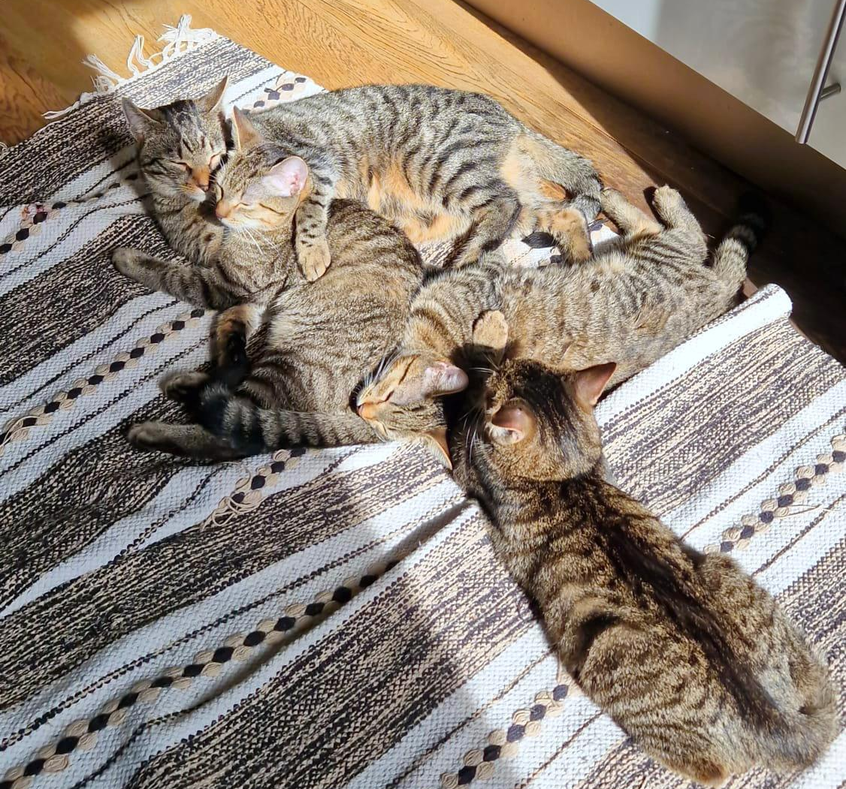
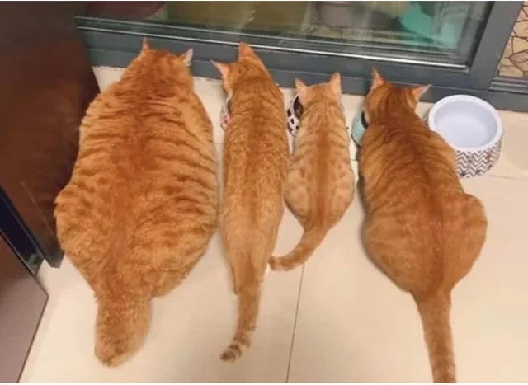
Unsupervised Learning
group 1?
group 2?
Notes:
Lets say you were to show a person who has no experience in identifying cat breeds, this image. However, you could still expect them to be able to sort the cats into groups with their respective breed, even if they don’t know what the breed is specifically, or how cats of that breed look. This is how unsupervised learning works, where you give a model your data without the answers, and it identifies patterns within that data to learn or infer some underlying structure.

Slide 4
Unsupervised Learning
Clustering
Dimension reduction
ChatGPT
Notes:
As you can imagine, unsupervised learning is a very broad term. Let’s narrow the discussion a bit by focusing on only two types of unsupervised learning: clustering and dimension reduction. I’ll explain clustering first.

Slide 5
k-means clustering
Comfort
Fashion
Notes:
Clusters are pretty interesting. They rely on the natural similarities between sections of your data. Imagine that you’re plotting Fashion versus comfort for shoes. You’re analyzing people’s opinions of sneakers, crocs, slippers, and so on. When you analyze specific shoes you see that some of them are more similar to each other than they are to other shoes so (click)
…this green cluster could be the slippers: comfortable but not as fashionable (click)
…this blue cluster could be the sneakers: fashionable but not as comfortable (click)
…and this yellow cluster could be the crocs: both fashionable and comfortable
So clusters can tell us specifics about the relationship of data (click)…
even if your data is unlabeled!
Now this begs the question… (click) how do we find the clusters?

Slide 6
k-means clustering
Comfort
pick a K-number of clusters
randomly pick a series of “centroids”
assign each particle to the centroid closest to it
k=6
Fashion
Notes:
The algorithm itself is pretty straightforward.
K-means clustering is just one algorithm (it can also be used to find outliers)
We first pick a certain number of clusters, k (click)…
This is a hyperparameter which we can adjust manually ourselves. (click)
Next, we randomly place down k centroids throughout our data. (click)…
Nothing too special here, just remember that this step is completely random (click)
And our third step is to assign each datapoint, or “particle” to the centroid closest to it (click, NEXT)

Slide 7
k-means clustering
Comfort
pick a K-number of clusters
randomly pick a series of “centroids”
assign each particle to the centroid closest to it
move the centroid to the geometric center of samples assigned to it
k=6
Fashion
Notes:
Here, the datapoints have been colored in based on what centroid they’re closest to. They’ve been “assigned” to the closest centroid.
Now, the next step is (click) to move the centroid to the geometric center of the samples assigned to it. (next slide)

Slide 8
k-means clustering
Comfort
pick a K-number of clusters
randomly pick a series of “centroids”
assign each particle to the centroid closest to it
.
.
move the centroid to the weighted geometric center of samples assigned to it
,
,
Repeat 3-4 until centroids stop moving!
k=6
Fashion
Notes:
Now take a look: The centroids have just moved closer to their group. However, now that the centroids themselves have moved, the datapoints may be closer to a different centroid now.
You see those two blue dots in the pink cluster? Are they reaaally closer to the blue centroid or to the pink one? This brings us to our last step which is to simply (click) repeat steps 3-4 until the centroids stop moving!
Let’s do step 3 again and reassign the datapoints and see what it looks like (next slide)

Slide 9
k-means clustering
Comfort
pick a K-number of clusters
randomly pick a series of “centroids”
assign each particle to the centroid closest to it
.
.
move the centroid to the weighted geometric center of samples assigned to it
,
,
Repeat 3-4 until centroids stop moving!
k=6
Fashion
Notes:
That looks better.
However, since we’ve just changed the datapoints near the centroid, the weighted geometric center of the samples may have changed. Let’s repeat step 4 now. (next slide)

Slide 10
k-means clustering
Comfort
pick a K-number of clusters
randomly pick a series of “centroids”
assign each particle to the centroid closest to it
move the centroid to the weighted geometric center of samples assigned to it
Repeat 3-4 until centroids stop moving!
k=6
Fashion
Notes:
Alright! Now our centroids have stopped moving. This occurs when the reassignment of the datapoints doesn’t change what centroid they are attached to.
What I’ve described here is called the k-means clustering algorithm. (WAIT FOR QUESTIONS).
The reason why this is such a good, and popular way to find clusters, is that it can exclude outliers. Theres also many uses for doing k-means, like feature importance.
Something to keep in mind is that with k-means clustering, (click) every time you run it you may actually end up with different clusters and that’s okay. (next slide).

Slide 11
Do we always get back the same clusters?
Nope. And that’s OK.
K-means is an indeterministic algorithm—it has built-in randomness
Notes:
There’s a certain degree of randomness built into the algorithm and this randomness comes from the first step where we placed the initial centroids down (click)
This algorithm is called an indeterministic algorithm due to this built-in randomness.

Slide 12
Unsupervised Learning
Clustering
Dimension reduction
ChatGPT
Notes:
Let’s quickly summarize. We’ve fully covered k-means clustering which involves calculating the centroids of groups of data, grouping points based on their closeness to those centroids, and repeating these steps until the centroids stopped changing.
Now, we’ll be moving into another subset of unsupervised learning called dimensionality reduction. And I’ll talk about why we might be interested in the reducing the number of dimensions of our dataset, and how to do it safely through a method called principal component analysis.

Slide 13
Principle Component Analysis
Comfort
Most basic approach
Fashion
Notes:
So to start, WHY do we want to use dimensionality reduction? It sounds like a useless tool: why should we intentionally cut out some of our valuable features? Well the main goal here is to simplify our dataset; to bring down the number of dimensions and consequently bring down the complexity of the dataset. This allows our models to run faster and have a lower risk of overfitting.
Of course there are downsides, namely, we are inherently losing information by cutting off some dimensions of our dataset. This itself is unavoidable, but there are clever ways of minimizing this downside through algorithms such as PCA.

Slide 14
Principle Component Analysis
“ComfortFashion”
Comfort
Fashion
Notes:
To explain PCA I’m going to start by drawing this rather boring line. The specific algorithm for determining where and how the line should be drawn involves a lot of dense linear algebra which we won’t cover for the sake of time. However, I will briefly explain how the math works intuitively later on.
So. Back to our line. The way we use this is we pretend like this line represents our new axis. In our case, this line represents some linear combination of both fashion and comfort (click).
Let’s call this new axis our “ComfortFashion” axis. Let’s now project all our data onto this new axis.

Slide 15
Principle Component Analysis
“ComfortFashion”
Comfort
less dimensions, easier to work with!
how to pick a good line?
Fashion
by projecting the samples down to a smaller dimension, they are easier to work with.
Notes:
And now, we reach our final result. (click)
We’ve cut the number of dimensions from 2 to 1 but in a way such that we didn’t lose much information. We can now treat this new dataset like our old one and run algorithms like clustering on it again while still retaining much of the original effectiveness.
Of course, this example is a toy example since, for the sake of visualization, there were only two dimensions to begin with. But in datasets like the wine dataset with over 10 different dimensions, condensing some of its dimensions becomes much more beneficial.
Now let’s return to a part I glossed over previously. (click) How exactly do we find a “good” line?

Slide 16
Principle Component Analysis
how to pick a good line?
Comfort
which one is better?
Fashion
Notes:
Let’s take a step back to our original, non-compressed data and I’ll bring up two lines we could have used for PCA. How do we tell which line is better for PCA?
Remember that our original goal is to cut a dimension without losing too much information. This second part is important; our focus is on retaining information, or more precisely, we want to retain as much variation as possible.
So what exactly do I mean by “retaining variation”? I’ll demonstrate with a visual example. Let’s see what happens if we use the red line as our principle component.

Slide 17
Principle Component Analysis
how to pick a good line?
Comfort
“mushed”
variation not captured
Fashion
Notes:
We see that there’s a lot of our data overlapping and mushed on top of each other. This is an example of variation not being captured as everything is kind of in the same spot.
So back to principle component analysis. What we want is a line that retains as much variation as possible and minimize this mushing. This, as a result, lets us retain as much information as possible when cutting dimensions.
MENTION OVERFITTING
Provide a real world example e.g. genes

Slide 18

principle component analysis
Principle Component Analysis
how to pick a good line?
Comfort
But, can we formalize it?
Find a good line (basis) that maximizes variation
Project samples down
Fashion
Notes:
Formally, the procedure for principle component analysis is to, first, find a good basis line that maximizes variation. This is what we just talked about.
PCA is mainly used to prevent overfitting
Explain the WHY
Next, we simply project our samples onto this new dimension to complete the procedure. And that’s all there is to it. (QUESTIONS)
Next up…

Slide 19
Unsupervised Learning
Clustering
Dimension reduction
ChatGPT
Notes:
Let’s quickly summarize. We’ve fully covered k-means clustering which involves calculating the centroids of groups of data, grouping points based on their closeness to those centroids, and repeating these steps until the centroids stopped changing. Now, lets move on to ChatGPT
Now, we’ll be moving into another subset of unsupervised learning called dimensionality reduction. We’ll be why we might be interested in the reducing the number of dimensions of our dataset, and how to do it safely through a method called principal component analysis.

Slide 20

Case study: LLMs
Notes:
So, ChatGPT is what is called a “LLM”, short for Large Language Model

Slide 21
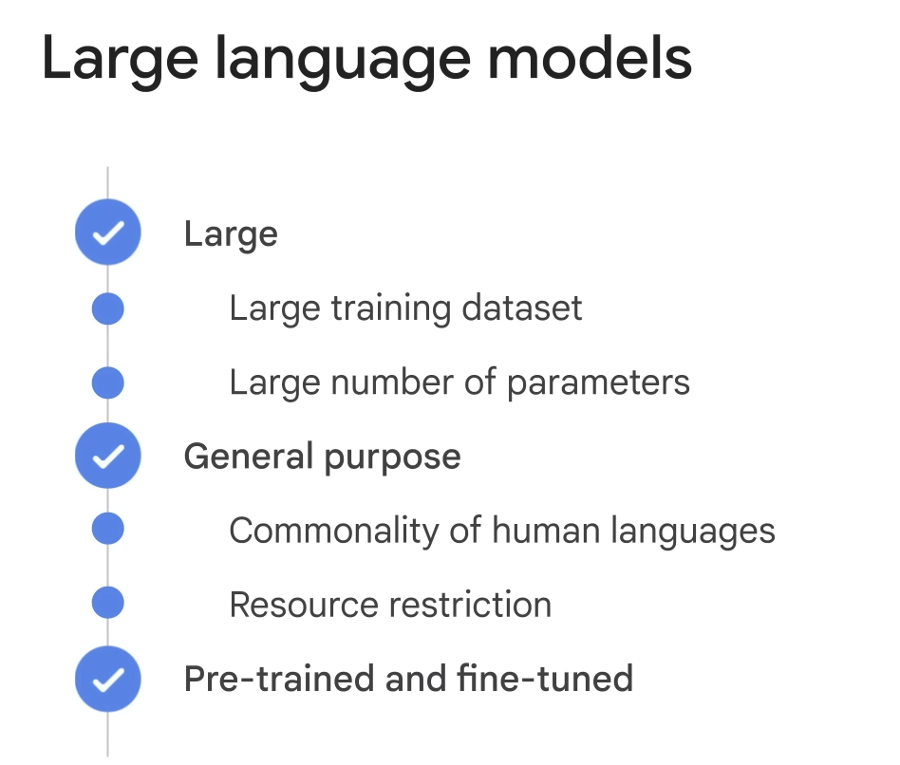
Notes:
You may have heard of this name before, and it’s what popularized this recent AI boom. When people think about an LLM, then tend to think about model size. The “large” in LLM references its datasize, specifically it’s text corpus. These corpuses can contain trillions of words. More importantly, LLMs are often trained as general purpose models. In other words, it learns the commonality of human languages, as we described earlier. For such large efforts, not many companies/organizations/people can afford. Only a few large cooperations. Therefore, these models are often pretrained and can be fine-tuned to do specific tasks. We will talk about fine tuning in a few slides.
These embeddings are then processed by the model's neural network,

Slide 22
How do LLMs work?
Text input
GPT
Next word
Notes:
In a large language model (LLM), such as GPT-4o, the model takes raw input as text in a sequential manner. The input text is typically passed to the model in the form of a string or a list of strings. When feeding the input to the model, it is important to consider the maximum token limit imposed by the model. Tokens are chunks of text that the model processes, and each token can be as short as one character or as long as one word, depending on the tokenizer used. The maximum token limit varies depending on the specific model variant, with GPT-3 having a limit of 4096 tokens and GPT-4 having a limit of 8000 tokens.

Slide 23
How do LLMs work?
0.9
0.05
0.03
0.02
This one!
Text input
GPT
Notes:
After the input text is tokenized, it is converted into numerical representations called embeddings, which capture the semantic meaning of the tokens.
This is a very critical concept. This is why ChatGPT generates different answers if you try at multiple times. This is also the generation part. Why it is not “accurate”. It is not supposed to be ”accurate”. It meant to mimic human language.

Slide 24
How do LLMs work?
Now we repeat and generate more text!
“Hi, how”
GPT
“are”

Slide 25
How do LLMs work?
Now we repeat and generate more text!
“Hi, how are”
GPT
“you”

Slide 26
How do LLMs work?
Now we repeat and generate more text!
“Hi, how are you”
GPT
“today?”

Slide 27
How do LLMs work?
Now we repeat and generate more text!
GPT
“Hi, how are you today?”
Notes:
Does anyone have any questions?

Slide 28
Training LLMs
How are LLMs then trained to do this as well as possible?
Self-supervised learning.
Notes:
Right now, AI cannot truly “think” with humans, and instead are more focused on menial retrieval and structural generation tasks, as we’ll see later on in this lecture.
Explanation of present-day AI as "weak" AI, requiring human-in-the-loop feedback, prompt engineering, and other interventions.

Slide 29
Training LLMs
The process behind self-supervised learning
“Hi, how are you today?”
Notes:
Right now, AI cannot truly “think” with humans, and instead are more focused on menial retrieval and structural generation tasks, as we’ll see later on in this lecture.
Explanation of present-day AI as "weak" AI, requiring human-in-the-loop feedback, prompt engineering, and other interventions.

Slide 30
Training LLMs
The process behind self-supervised learning
Hi | how | are | you | today
Notes:
Right now, AI cannot truly “think” with humans, and instead are more focused on menial retrieval and structural generation tasks, as we’ll see later on in this lecture.
Explanation of present-day AI as "weak" AI, requiring human-in-the-loop feedback, prompt engineering, and other interventions.

Slide 31
Training LLMs
The process behind self-supervised learning
xxxxx | how | are | xxxxx | today
Notes:
Right now, AI cannot truly “think” with humans, and instead are more focused on menial retrieval and structural generation tasks, as we’ll see later on in this lecture.
Explanation of present-day AI as "weak" AI, requiring human-in-the-loop feedback, prompt engineering, and other interventions.

Slide 32
Training LLMs
The process behind self-supervised learning
xxxxx | how | are | xxxxx | today
Task: predict the missing words as best as possible.
Notes:
Right now, AI cannot truly “think” with humans, and instead are more focused on menial retrieval and structural generation tasks, as we’ll see later on in this lecture.
Explanation of present-day AI as "weak" AI, requiring human-in-the-loop feedback, prompt engineering, and other interventions.

Slide 33
Is this enough?

Slide 34
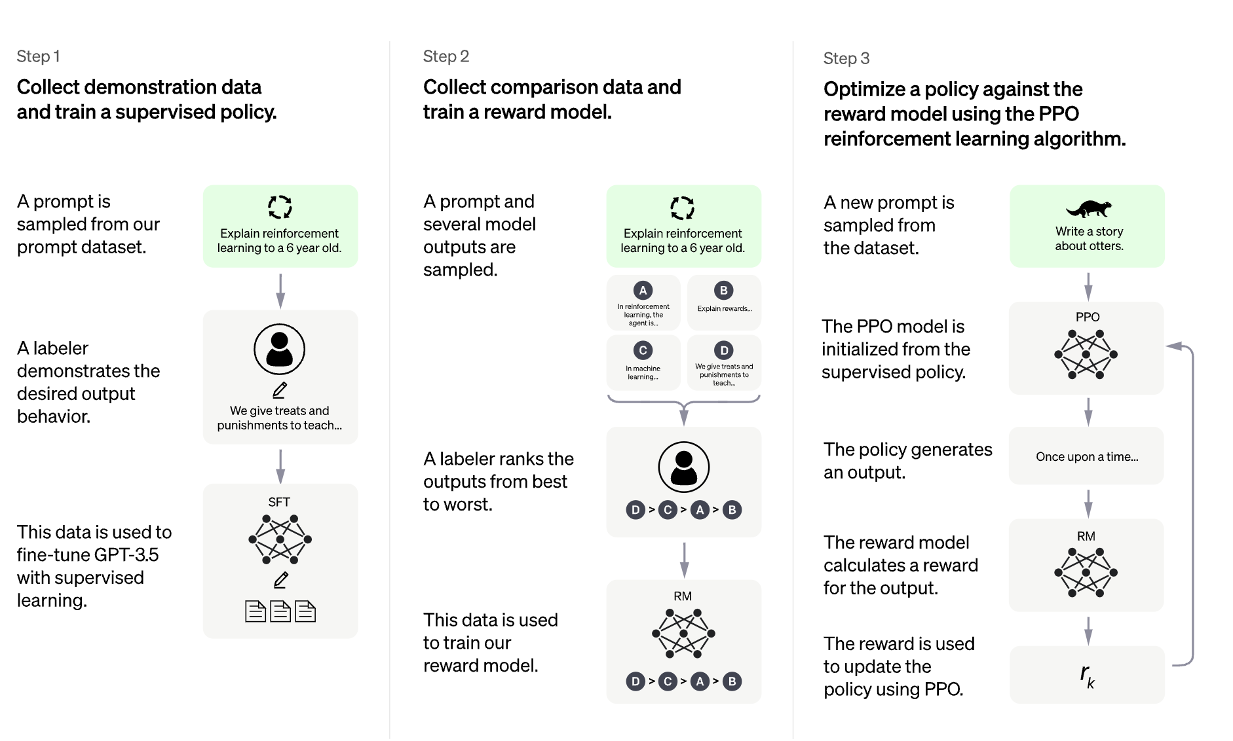
Fine-tuning
Reinforcement-learning via human feedback (RLHF)
Notes:
Why is Fine-tuning needed? It plays several important roles.
One is that it aligns the model with human values. Second, this is required for a more specific, tailored model. Third, it teaches the model grammatical convention.

Slide 35
Fine-tuning
Step 1 – collect human feedback
Notes:
The first step of fine-tuning is to get human response that a model can mimic.

Slide 36
“What is the highest mountain?”
“The highest mountain is Himalayas.”
Basic Model
“A. Himalayas; B. K2; C. .”
“Do you know?”
Notes:
Next token generation can already be very powerful. But is it enough. For example, if we ask the model a question,… remember this is a probability model. So It is possible for it to generate multiple different answers. All similar to what it has seen. The first one is probably a correct answer it finds somewhere. The second could come from some Internet text when a teacher posted an exam multi-choice question. The third one could be a rhetorical question again seen in its corpus.All these are reasonable, human-like text. After all, we probably seen something like this in our daily language. But to answer the question, we probably want chatGPT to give us the first answer. To address this issue, it comes to be fine-tuning part of ChatGPT

Slide 37

“What is the highest mountain?”
Human labeling
“The highest mountain is Himalayas.”
Basic Model
“A. Himalayas; B. K2; C. .”
“Do you know?”
Notes:
Next token generation can already be very powerful. But is it enough. For example, if we ask the model a question,… remember this is a probability model. So It is possible for it to generate multiple different answers. All similar to what it has seen. The first one is probably a correct answer it finds somewhere. The second could come from some Internet text when a teacher posted an exam multi-choice question. The third one could be a rhetorical question again seen in its corpus.All these are reasonable, human-like text. After all, we probably seen something like this in our daily language. But to answer the question, we probably want chatGPT to give us the first answer. To address this issue, it comes to be fine-tuning part of ChatGPT

Slide 38
Fine-tuning
This data is used to train a reward model.
Notes:
The human ratings and rankings collected in the previous step are used to train a separate model called the "reward model." This reward model learns to predict how humans would score or rank the responses generated by the LLM. Essentially, the reward model is trained to mimic human judgments and preferences, allowing it to assign a "reward" score to any given response from the LLM.

Slide 39
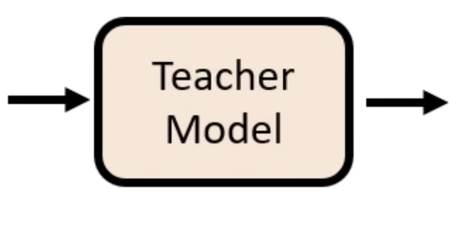
“What is the highest mountain?”
“The highest mountain is Himalayas.”
“A. Himalayas; B. K2; C. .”
“The highest mountain is Himalayas.”
“Do you know?”
Notes:
Such information is used to train a so-called teacher model. Basically, the teacher model learns how to compare answers. If the question and these three answers are given to the teacher model, at inference time, it tells us the first answer is better. Again this is unsupervised learning. The training dataset is generated (the ranks) by humans. At inference time, ,…

Slide 40
Fine-tuning
The reward model and new data are then used to actually fine-tune.
Notes:
The human ratings and rankings collected in the previous step are used to train a separate model called the "reward model." This reward model learns to predict how humans would score or rank the responses generated by the LLM. Essentially, the reward model is trained to mimic human judgments and preferences, allowing it to assign a "reward" score to any given response from the LLM.

Slide 41
“What is the highest mountain?”
“The highest mountain is Himalayas.”
GPT
Reward signal

Slide 42
Now that we’re familiar with LLMs…

Slide 43
Things to look out for
LLMs generate content probabilistically.
Because the goal of LLMs is to emulate human speech, they are susceptible to hallucinations.
Notes:
Lawyer mistake happened in 2023

Slide 44
Things to use AI for
“If I had to take one of the top use cases [for Microsoft Copilot], it’s summary. It’s helping people make content more digestible.”
- Divya Kumar GM of search and AI marketing, Microsoft
Notes:
Despite those pitfalls, AI is still useful.

Slide 45
Things we’re using AI for
Content summary – a lot of information coming in at once
Retrieval and synthesis
Structure generation: text, code, and much more!
Notes:
There are also a lot of LLM tools e.g. GPT store, which are fine-tuned for a lot of different purposes. You can explore everywhere if you want, but we're going to give you one example.

Slide 46
CASE STUDY: Solving a coding problem with AI

Slide 47
Let’s say I want to build my own logistic regression model. What would I need?

Slide 48
LLM Tips
Be as specific as possible
The power of “Act as if…”
Have it explain its thoughts step-by-step
“Be concise”
Notes:
Here are some prompting tips.

Slide 49
Chatbot Workflow
1. Brainstorm what we need…with the help of AI!
Notes:
Prompt: Act as if you're a thoughtful and highly experienced software developer. I want advice on what intermediate packets I would need in order to build my own highly effective logistic regression model.
In the development process, I would like to use only Python as the language in the backend, specifically with the packages pandas and scikit-learn. Assume we're going to use the iris dataset from the load_iris function.
Please provide me a list in order from most to least important, and give a short explanation about what each element might entail and why it's important.

Slide 50
Chatbot Workflow
Brainstorm what we need…with the help of AI!
Turn the ideas into a workflow…with the help of AI!
Notes:
Prompt: Given these ideas, can you now generate me a step-by-step workflow that you would use to code the logistic regression model? You don't need to generate any code, just describe how it would work.

Slide 51
Chatbot Workflow
Brainstorm what we need…with the help of AI!
Turn the ideas into a workflow…with the help of AI!
Edit the workflow as necessary.
Notes:
Prompt: We will now enter an editing phase in order to modify the workflow as thoroughly as possible. For each round, you will prompt the user for feedback, then ingress the feedback, make changes, and rewrite the workflow given above. Keep prompting for feedback until the user is sufficiently satisfied with the workflow.
Edit #1: Assume we're going to be coding in Google Colab. Assume also that the model is just for personal use, so it doesn't need to be deployed or saved anywhere and can be kept within Colab. Would the workflow then change?
ASK AUDIENCE FOR FURTHER EDITS, ETC.

Slide 52
Chatbot Workflow
Brainstorm what we need…with the help of AI!
Turn the ideas into a workflow…with the help of AI!
Edit the workflow as necessary.
Execute the workflow…with the help of AI!*
Notes:
Prompts:
Are you able to explore the iris dataset for me? If so, can you provide me with a series of explicit conclusions?
Given these explicit conditions, can you give me 3-5 preprocessing steps that you would do for this dataset? Please be as specific as possible to the point of writing pseudocode.
Can you go ahead and write the code for everything up to Step 9?
If you were to generate a series of 50 completely new test data points, could you describe a step-by-step workflow for doing this?
Can you use the workflow you just described to generate a series of 20 new test data points, then evaluate the Logistic Regression model you generated with those new datasets?
Etc.

Slide 53
CASE STUDY: Making a demo slide deck with AI

Slide 54


Case study: Workflow
Notes:
Here, we will be using Gamma, an AI presentation generator, and ChatGPT

Slide 55
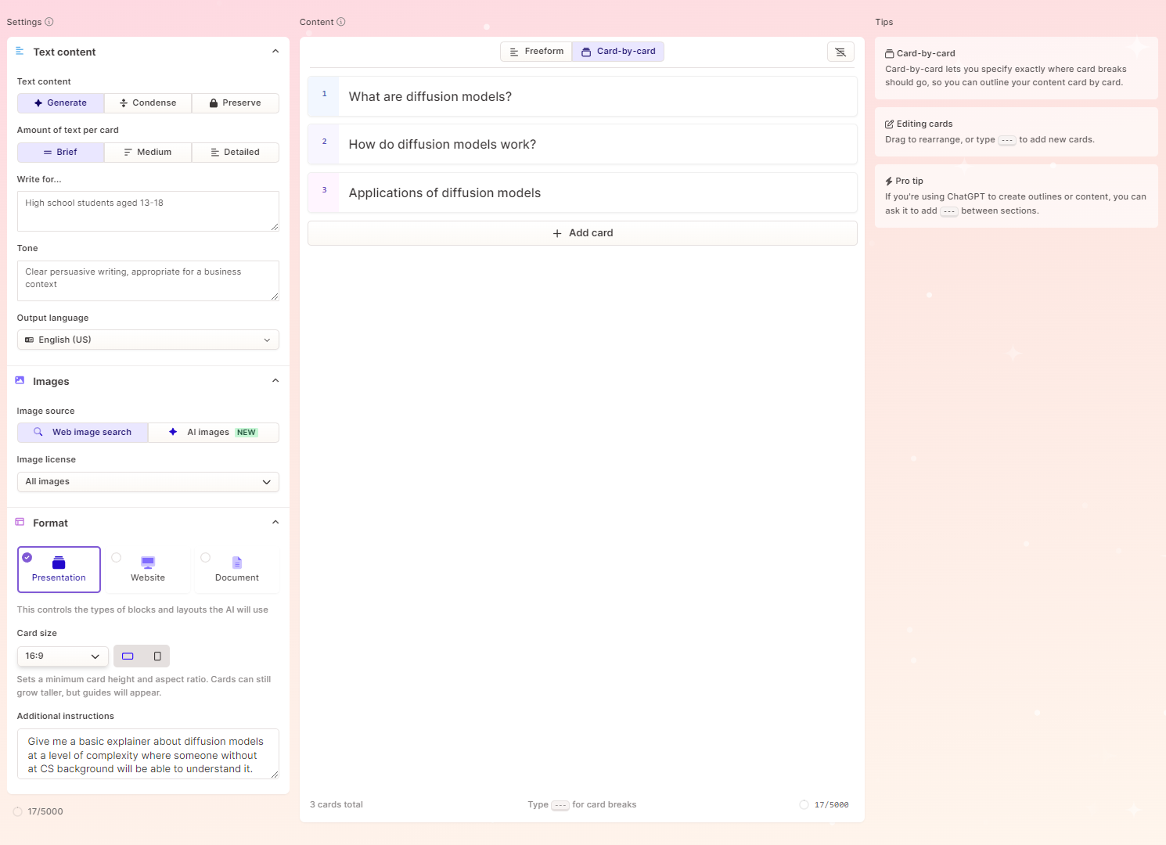
Case study: Understanding Gamma
2. Audience and Tone: Where we plug in a description of the target audience the presentation will be made for, and the tone we want the presentation to take on.
1. Cards: Where the actual content of the presentation is actually contained and written. This is where we will put in an outline of the content we want to generate.
3. Additional Instructions: We can add additional fine-tuning instructions for the generation engine, such as what to emphasise, whether to add more images or text, etc.
Notes:
Right now, AI cannot truly “think” with humans, and instead are more focused on menial retrieval and structural generation tasks, as we’ll see later on in this lecture.
Explanation of present-day AI as "weak" AI, requiring human-in-the-loop feedback, prompt engineering, and other interventions.

Slide 56
Here’s an example presentation:

Slide 57


Introduction to Python

Slide 58
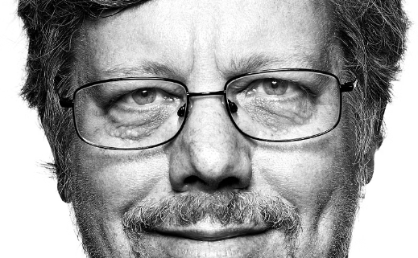
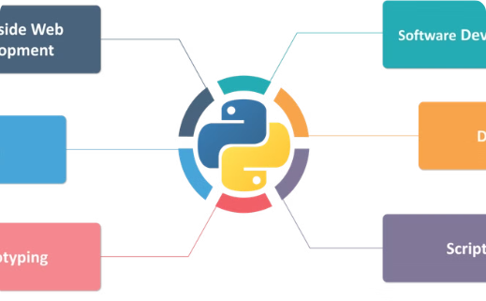
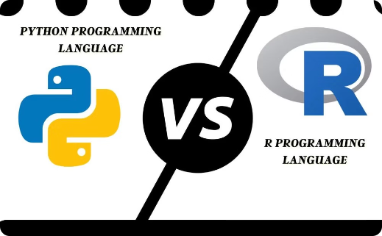
Python's Origin and Uses
Invention: 1980s
Versatile Applications
Comparison to R
Invented by Guido van Rossum
Python's versatility and performance make it a popular choice over R.
Python is used for web development, data analytics, machine learning, and more.

Slide 59




Google Colab
Google Drive
Shareable
No Setup
Pre-installed
Stores everything on Google Drive for easy access.
Easily share and collaborate on notebooks.
No installation required, just open in the browser.
Most popular packages and libraries are pre-installed.

Slide 60
General Python Syntax
Functions
Comments
Take inputs and give outputs:
Use # to add comments for code readability
print("hello world")
# I am a comment!
Prints the given input (in this case, "hello world").

Slide 61
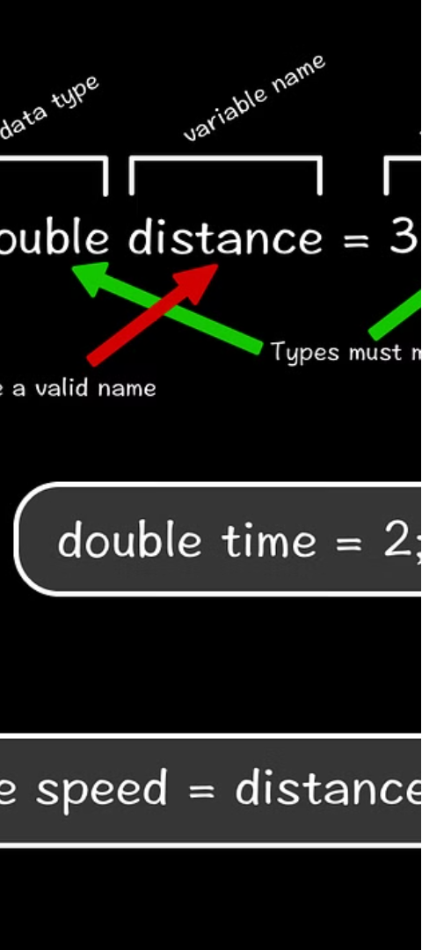
Variables Overview
Containers for Values
Variable Creation
Variables store different types of data.
Assign values using variable_name = value.
Usage
Reassignment
Variables can be used after they're assigned
Variables can be reassigned as needed

Slide 62

Variable Names
Naming Rules
Good Practices
Avoid Confusion
Cannot start with a number, no spaces, cannot be a keyword.
Use descriptive names, all lowercase with underscores.
Follow conventions to make code more readable and maintainable.

Slide 63
What do we think?

Slide 64
Overall: not bad, but there’s still room for improvement.

Slide 65
TAKEAWAYS

Slide 66
Using ChatGPT in the real world
How can we make LLMs useful?
Remember, LLMs are probabilistic.
We need to ask good questions.

Slide 67
Using ChatGPT in the real world
So what are good questions?
Give specific instructions to ChatGPT
Make sure you leave little to no room for error!
Treat the answers like suggestions, not facts
It’s good at a lot of things, but not great at one particular thing
The niche problem

Slide 68
In general, treat it like you’re talking to another person!

Slide 69
ChatGPT limitations
Much like a person, ChatGPT has its own limitations:
It lacks truthfulness.
When researching in a highly specialized niche, it tends to begin making up false information or information riddled with errors.
Speed and efficiency of usage

Slide 70
Still, it’s a very powerful tool.

Slide 71
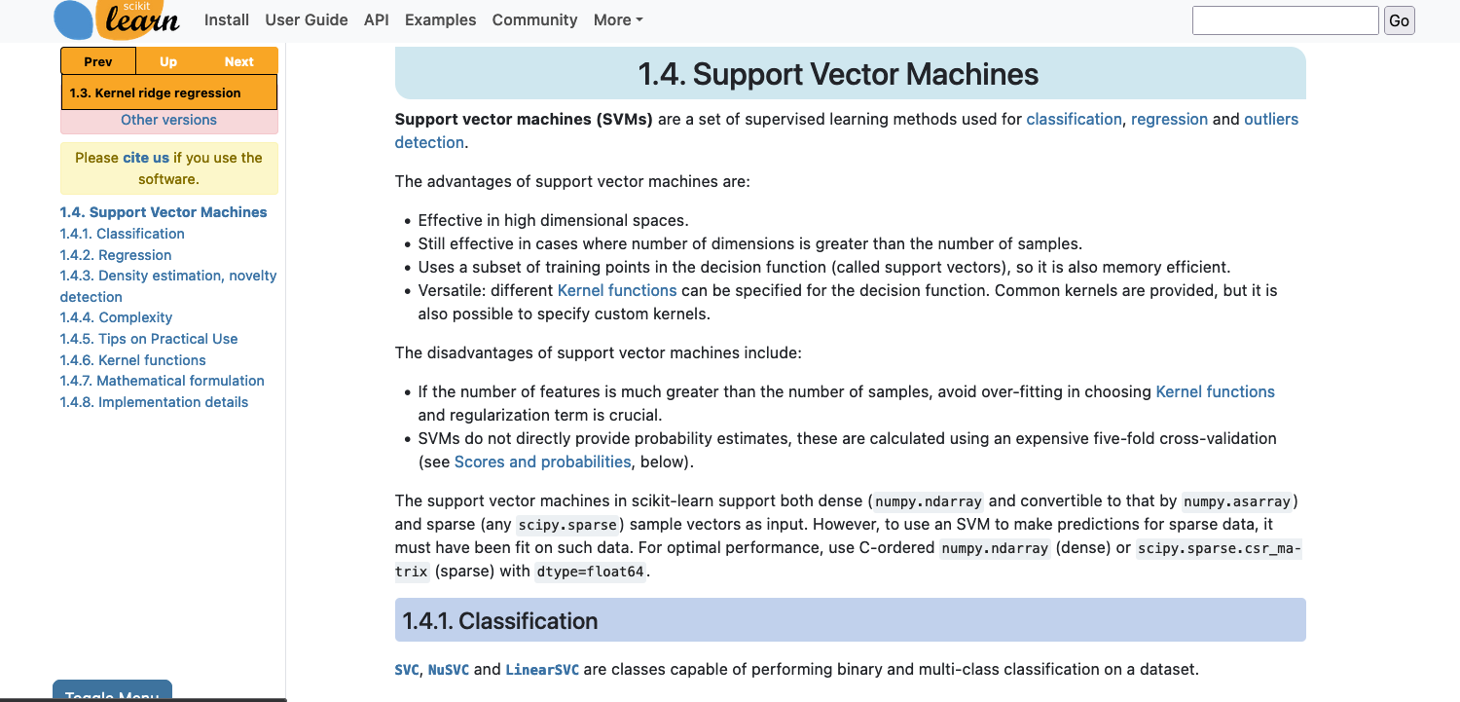
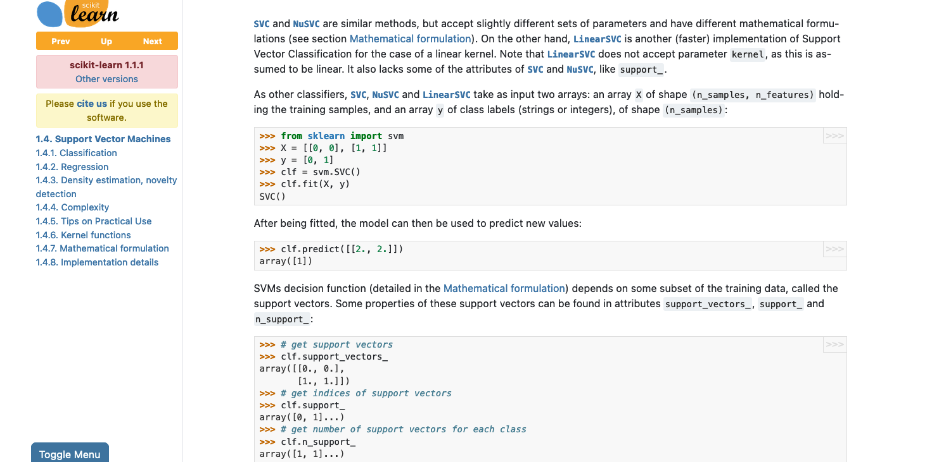
Cool, so…
what’s next?
scikit-learn.org

Slide 72

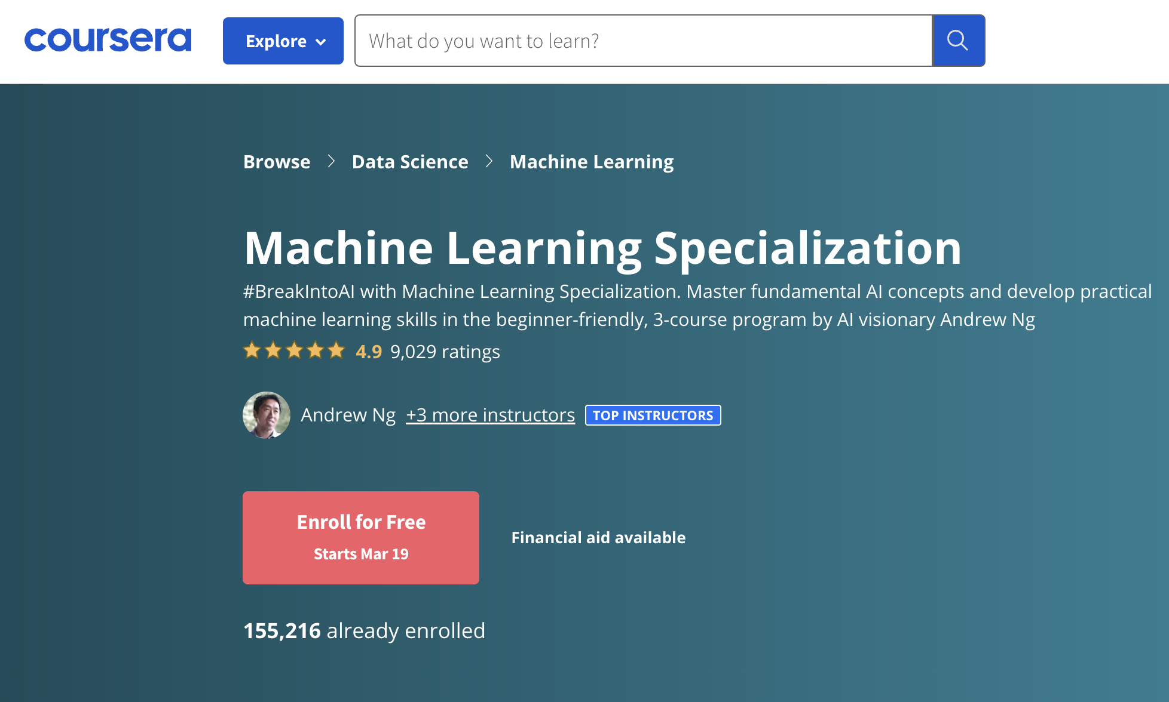

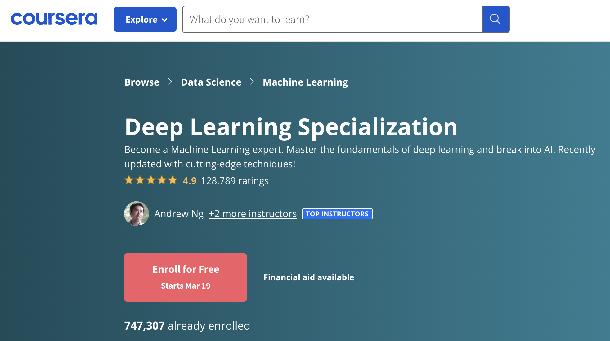
Cool, so…
what’s next?

Slide 73

(and have lots of fun!)

Slide 74

Thank you.

Slide 75

AIBridge
Samuel Ren, Henry M Gunn High School
Jiaming Situ, Homestead High School
Houjun Liu, The Nueva School
Xin Liu, Professor, Computer Science. UC Davis
With acknowledgments to
AI Institute for Food Systems
Saratoga Public Library

